Slide 1
The Field of Data Science
Machine Learning
Shahriar’s Analytical Academy

Slide 2
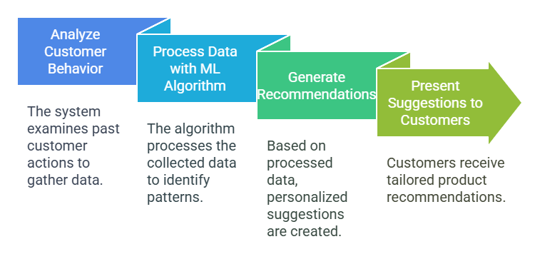
Definition and Example
Machine Learning is a subset of artificial intelligence (AI) that enables machines to learn from data and make decisions or predictions without being explicitly programmed. It involves algorithms and statistical models that allow systems to learn from historical data, identify patterns, and improve performance over time.
Notes:
Machine Learning (ML) is a subset of artificial intelligence (AI) that allows machines to learn from data and make decisions or predictions without being explicitly programmed. Instead of following pre-defined rules, ML systems use algorithms and statistical models to learn from historical data, recognize patterns, and improve their performance over time. This capability enables systems to make increasingly accurate predictions or decisions based on new data.
Example Scenario:
Company: E-commerce platform (e.g., Amazon)
Task to Automate: Personalized Product Recommendations
How It Works: The ML algorithm analyzes past customer behaviors on the platform, such as the products browsed, purchased, and reviewed. It collects data on each customer's preferences and purchase history to identify patterns. By recognizing these patterns, the algorithm learns which products are more likely to interest each customer.
Automation: Once the model is trained, it automatically generates personalized product suggestions for each customer. These recommendations appear as they browse the site, enhancing their shopping experience. For example, if a customer has previously purchased electronics, the system may suggest related products like phone accessories or new tech gadgets. This automation leads to improv

Slide 3
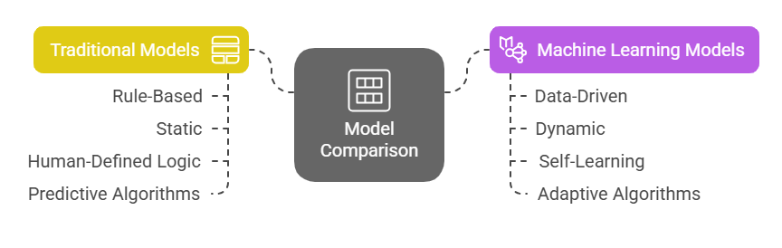
Traditional model v/s Machine learning
Notes:
1. Rule-Based vs Data-Driven: Traditional models are rule-based, meaning they are explicitly programmed with fixed, predefined rules by human experts. These rules dictate how the system should behave under certain conditions, and any decision-making process follows these set rules strictly. In contrast, machine learning models are data-driven, meaning they learn from historical data to identify patterns and make predictions. Instead of being programmed with specific rules, machine learning models analyze past data to understand the relationships between variables and make decisions based on patterns in the data. This shift allows machine learning models to adapt and refine their predictions without human intervention.
2. Static vs Dynamic: Once traditional models are programmed, they are generally static—they do not change or adapt over time. If the conditions or data change, traditional models can become outdated and ineffective, requiring manual updates or reprogramming. On the other hand, machine learning models are inherently dynamic. They continuously learn and improve as they are exposed to new data. This adaptability ensures that machine learning models stay relevant and accurate even as new patterns emerge, making them more robust and flexible in the face of changing circumstances or evolving data.
3. Human-Defined Logic vs Self-Learning: In traditional models, human-defined logic is central. Experts define all conditions, thresholds, and relationships within the system. The model follows the logic set by humans, which can be limiting when dealing with complex or unexpected situations. Machine learning models, however, are self-learning. They automatically improve as they are exposed to more data. This self-learning capability allows machine learning models to evolve and fine-tune their decision-making processes based on the data they encounter, without the need for constant human intervention or reprogramming.
4. Predictive Algorithms vs Adaptive Algorithms: Traditional models rely on predictive algorithms, where the logic is assumed to be fixed and consistent across all scenarios. These models are designed to predict outcomes based on a predefined set of rules that do not change. However, machine learning models use adaptive algorithms, which can change and improve based on new data. When faced with new or unforeseen situations, machine learning models can adapt, learn, and refine their predictions, often improving their accuracy over time. This adaptability is crucial in environments where data is constantly evolving or where new patterns may emerge.

Slide 4
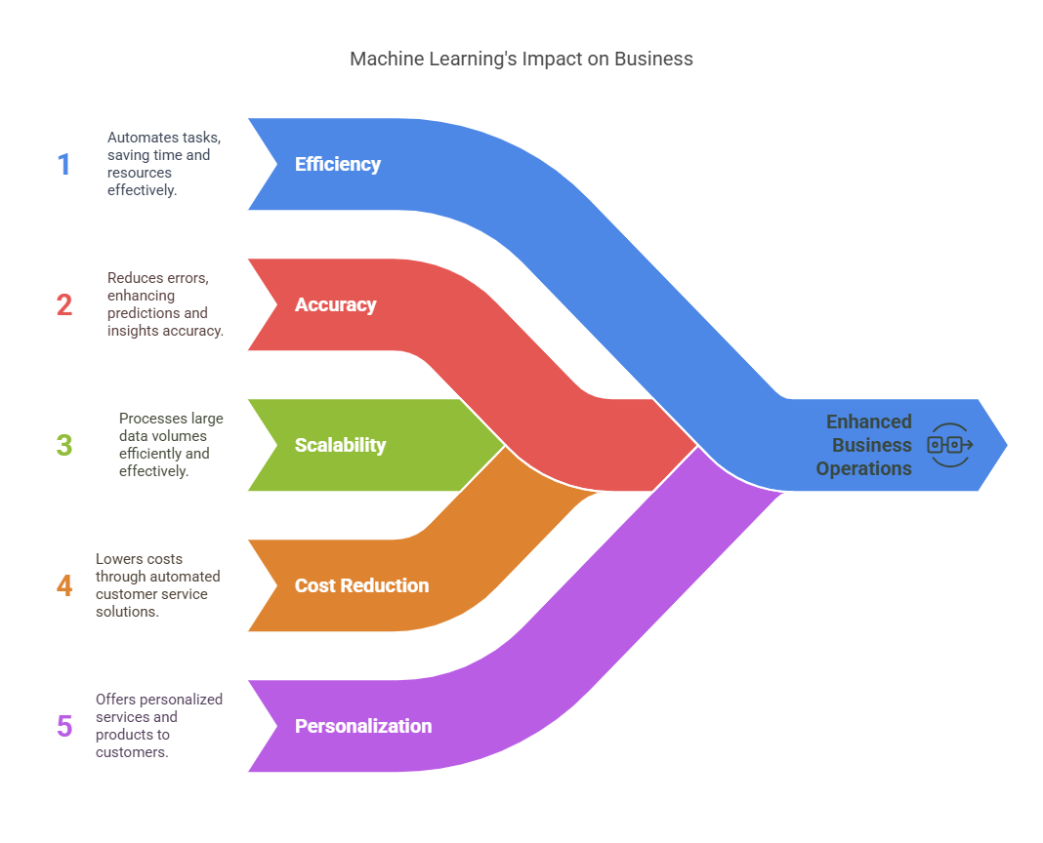
Importance of
Machine Learning
Notes:
Machine Learning (ML) plays a significant role in automation, and its benefits are evident in several ways. First, efficiency is greatly enhanced when tasks that would typically take humans a long time are automated. For example, ML can automate repetitive tasks like data entry or responding to common customer support queries, saving businesses a lot of time and resources.
Next, accuracy is improved with ML because it can make fewer mistakes than humans. When used in processes like demand forecasting or fraud detection, ML can analyze large amounts of data and provide more precise predictions and insights. This means businesses can make better-informed decisions.
Another important aspect is scalability. Unlike humans, ML models are capable of handling and processing huge volumes of data quickly. This ability allows businesses to manage large datasets without the need for additional manual labor, something that would be challenging for human workers.
Cost reduction is another major advantage. By automating tasks such as customer service with chatbots, businesses can significantly lower their operational costs. These automated systems can provide round-the-clock support without the need for human workers, reducing staffing costs.
Finally, ML helps with personalization. Companies can use ML to provide tailored recommendations or products to individual customers. For example, online stores can suggest products based on a customer's previous purchases or browsing history. This kind of personalization improves customer satisfaction and can lead to increased sales.

Slide 5
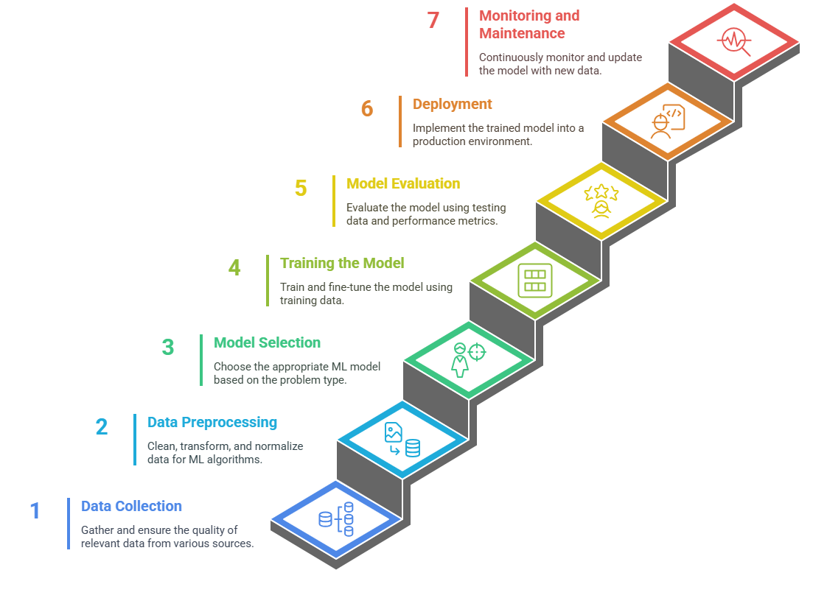
Steps in Machine
Learning Model
Development
Notes:
The process of developing a machine learning (ML) model involves several key steps, each of which plays a crucial role in ensuring the model works effectively.
1. Data Collection: The first step in building an ML model is to gather the relevant data. This data can come from various sources such as databases, sensors, or APIs (Application Programming Interfaces). It's important to ensure that the data collected is of good quality. For this, you need to check for any missing values, duplicates, or errors in the data to ensure it's reliable for further analysis.
2. Data Preprocessing: Once the data is collected, it needs to be cleaned and transformed into a format that ML algorithms can work with. This step, called data preprocessing, includes handling missing values, removing outliers (values that don't fit well with the rest of the data), and scaling features (adjusting the data to a common range). These processes help the ML model learn better from the data.
3. Model Selection: After preprocessing, the next step is to choose the right machine learning model based on the problem you're trying to solve. For example, if you're predicting a continuous value (like house prices), you would use a regression model. If you're classifying data into categories (like whether an email is spam or not), a classification model is more suitable. Common models include decision trees, neural networks, and support vector machines.
4. Training the Model: Once you've selected the model, it's time to train it. This involves splitting the data into two parts: one for training and one for testing. The training set is used to teach the model by letting it find patterns in the data. It's important to fine-tune the model during this phase to help it learn the most accurate patterns.
5. Model Evaluation: After training, you need to evaluate the model’s performance using the testing set. This helps you understand how well the model performs in real-world scenarios. You can use various performance metrics like accuracy (how many predictions were correct), precision (how many of the predicted positive results were truly positive), and recall (how many of the actual positive results were identified). If the model doesn’t perform well, you might need to adjust the parameters to improve its performance.
6. Deployment: Once the model is trained and evaluated, it’s ready for deployment. This means implementing the model into a live system where it can start making real-time predictions or automate tasks. For example, a recommendation system for an online store might suggest products to customers based on their browsing history.
7. Monitoring and Maintenance: Even after the model is deployed, it’s important to continuously monitor its performance. As new data comes in, the model may need to be updated to maintain accuracy. Regular maintenance ensures the model stays effective and adapts to any changes in the data over time.

Slide 6
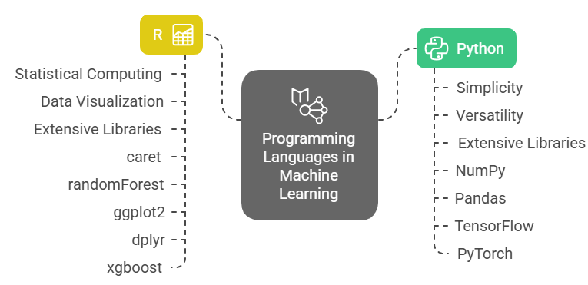
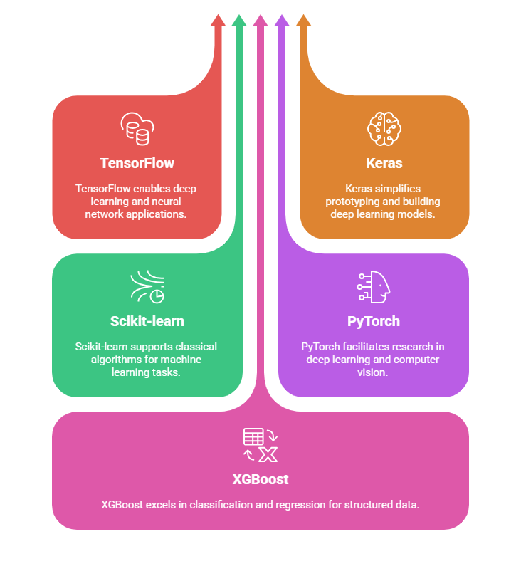
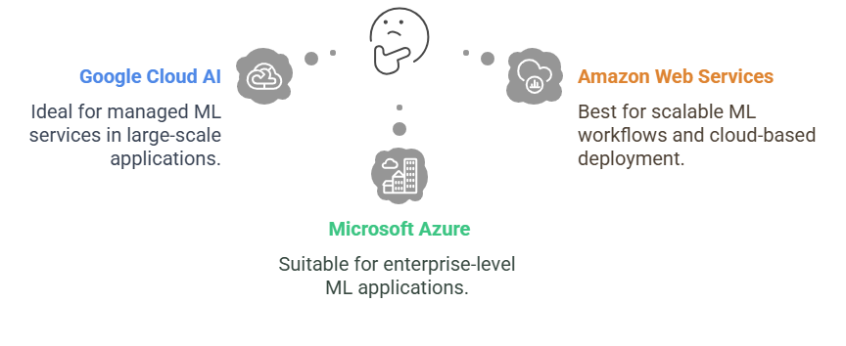
Tools in Machine Learning
Libraries
Notes:
Python is the most popular programming language for machine learning, and it is widely used due to its simplicity and versatility. The language is easy to read and understand, making it great for both beginners and experienced developers. Python also has a vast collection of libraries that make it incredibly powerful for machine learning tasks, such as data manipulation, visualization, and building sophisticated models. Libraries like TensorFlow, Scikit-learn, and PyTorch provide robust tools for creating and training machine learning models, from simple linear regressions to complex deep learning networks.
R is another highly preferred language for machine learning, especially in statistical computing and data visualization. R excels in data analysis and has extensive libraries for building machine learning models. It's particularly favored by statisticians and data scientists who focus on detailed data analysis and statistical testing. R also has excellent visualization tools, such as ggplot2, which make it easier to communicate data insights through graphical representations.
ML Frameworks & Libraries:
TensorFlow is an open-source framework developed by Google for deep learning and building neural networks. It is highly scalable and can run on various platforms like CPUs, GPUs, and mobile devices. TensorFlow is widely used in areas like image recognition, natural language processing (NLP), and reinforcement learning. It helps in building models that can classify images, understand text, and make decisions based on interactions with an environment.
Keras is a high-level API for building neural networks. It runs on top of TensorFlow, making it easier to create and train deep learning models with a more user-friendly interface. Keras is used for quick prototyping and building deep learning models. It’s perfect for developers who want to build models quickly without getting into the complexities of lower-level programming.
Scikit-learn is a Python library that provides simple and efficient tools for classical machine learning algorithms. It focuses on data mining, data analysis, and modeling, and is built on top of NumPy and SciPy. Scikit-learn is used for a variety of machine learning tasks such as regression, classification, clustering, and model evaluation. It's ideal for tasks like predicting outcomes, segmenting customers, or evaluating the effectiveness of different models.
PyTorch is an open-source deep learning framework developed by Facebook. It's known for its dynamic computation graph, which allows for greater flexibility when building neural networks and debugging models. PyTorch is widely used in research and development, especially in areas like NLP, computer vision, and deep learning tasks. Its flexibility makes it an excellent choice for experimenting with new algorithms and architectures in research environments.
XGBoost is a popular library designed for boosting algorithms, particularly focused on enhancing the performance of machine learning models. It is efficient and widely used for structured/tabular data. XGBoost is most commonly used for classification and regression tasks, particularly when dealing with structured data like customer data or sales data. It has become a go-to method for many Kaggle competition winners due to its accuracy and speed.
Cloud
Google Cloud AI provides a variety of powerful tools for building and deploying machine learning (ML) models. These tools include AutoML, which allows users to create custom models with minimal coding, and other custom AI solutions tailored to different business needs. Google Cloud AI is commonly used for managed ML services in large-scale applications. It's ideal for businesses that need to build and deploy AI solutions quickly without managing the underlying infrastructure themselves. This platform is also useful for companies looking to integrate AI into their existing operations, such as in image recognition or predictive analytics.
AWS offers a range of cloud-based services, including SageMaker, which is an integrated environment for developing, training, and deploying ML models. AWS provides scalable computing power and storage, making it easy to handle large datasets and complex ML tasks. AWS is used for scalable ML workflows and cloud-based deployment. It's an excellent choice for businesses needing to train large models or deploy AI solutions across multiple regions. SageMaker, in particular, is well-suited for companies that want an end-to-end solution for building and deploying machine learning models at scale.
Microsoft Azure offers Azure Machine Learning, a platform for creating, training, and deploying machine learning models. Azure provides a range of tools that allow businesses to work on AI projects in a collaborative and scalable way. Azure is often used for enterprise-level ML applications. It supports businesses that require a robust, secure platform for deploying machine learning models in production environments. This makes Azure ideal for large organizations looking to implement AI solutions across various departments, such as finance, marketing, and healthcare.

Slide 7
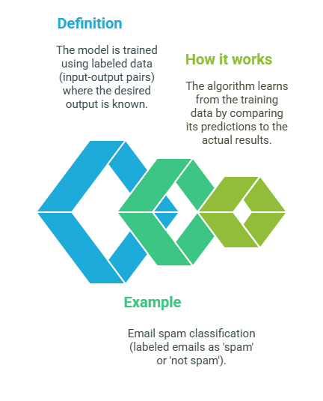
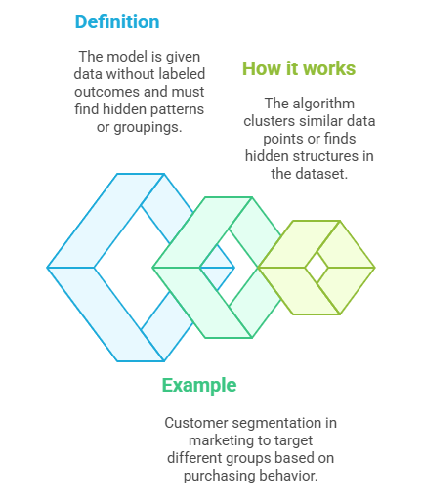
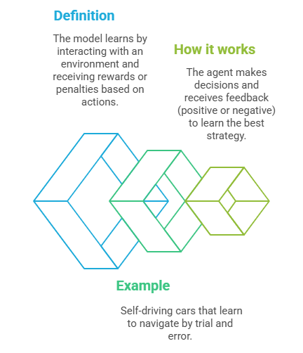
Types of Machine Learning
Supervised ML
Unsupervised ML
Reinforcement ML
Notes:
Supervised Learning:
Definition: Supervised learning is a type of machine learning where the model is trained using labeled data. This means that the data used for training consists of input-output pairs, where the desired output is already known. The model learns by being provided with both the input data (features) and the correct answers (labels).
How It Works: In supervised learning, the algorithm works by learning from the training data. It compares its predictions (what it thinks the output should be) to the actual results (the known output). By doing this repeatedly, the model adjusts itself to improve accuracy. Over time, it gets better at predicting the output for new, unseen data.
Example Use Case: An example of supervised learning is email spam classification. In this case, emails are labeled as either 'spam' or 'not spam'. The algorithm is trained with many emails where the label (spam or not) is known. It then learns patterns in the data (like certain keywords or phrases) and applies this knowledge to classify new emails.
Unsupervised Learning:
Definition: Unsupervised learning is a type of machine learning where the model is given data without labeled outcomes. This means that the algorithm does not have any predefined answers (like in supervised learning). Instead, it must explore the data and find hidden patterns or groupings on its own.
How It Works: In unsupervised learning, the algorithm analyzes the data to identify patterns, clusters, or structures. It clusters similar data points together or detects underlying relationships within the data. Unlike supervised learning, there is no specific "correct" answer to compare the predictions to. Instead, the model's goal is to find meaningful insights from the data on its own.
Example Use Case: A common example of unsupervised learning is customer segmentation in marketing. Businesses can use unsupervised learning to group customers based on their purchasing behavior without knowing beforehand what types of groups exist. The algorithm might identify clusters of customers with similar shopping habits, allowing the business to target each group with more personalized marketing strategies.
Reinforcement Learning:
Definition: Reinforcement learning is a type of machine learning where the model, called an agent, learns by interacting with an environment. The agent takes actions and receives rewards or penalties based on those actions. The goal is for the agent to learn which actions lead to the best outcomes over time.
How It Works: In reinforcement learning, the agent makes decisions based on the current state of the environment. After taking an action, the agent receives feedback in the form of a reward (positive feedback) or a penalty (negative feedback). This feedback helps the agent adjust its strategy to maximize rewards. Over time, the agent learns the best sequence of actions to achieve its goal, optimizing its behavior through trial and error.
Example Use Case: An example of reinforcement learning is self-driving cars. These cars learn how to navigate by making decisions (e.g., turning, speeding up, slowing down) and receiving feedback in the form of rewards (successful navigation) or penalties (e.g., colliding with obstacles). Over time, the car learns the most effective driving strategy to safely and efficiently reach its destination.

Slide 8
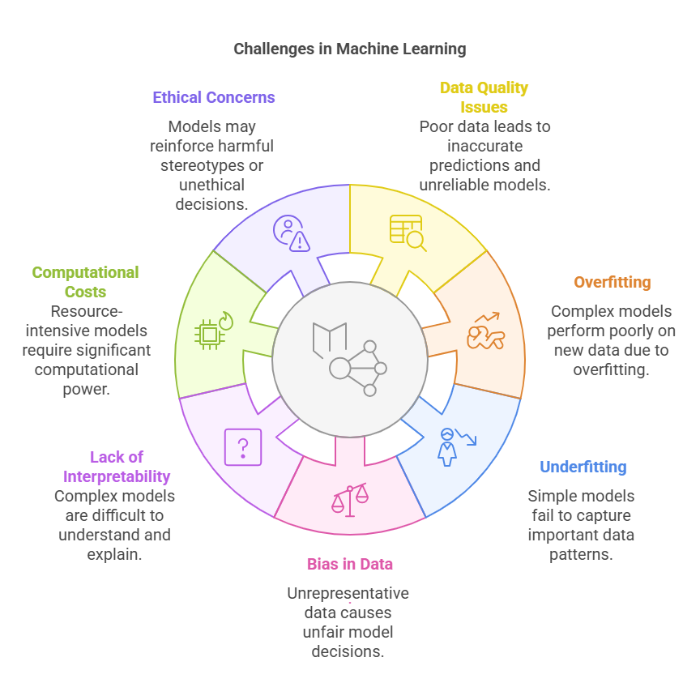
Challenges in
Machine Learning
Notes:
1. Data Quality Issues: Data quality is critical in machine learning. If the data is of poor quality—such as being incomplete, inconsistent, or noisy—it can lead to inaccurate predictions. For example, missing values, incorrect labels, or random errors in the data can cause the model to learn incorrect patterns, resulting in poor performance when making predictions on new data.
2. Overfitting: Overfitting happens when the model becomes too complex and learns the training data too well, including its noise and fluctuations. While the model may perform very well on the training data, it struggles to generalize to new, unseen data. This results in poor performance on real-world data. It's like memorizing answers instead of learning the underlying concepts.
3. Underfitting: Underfitting occurs when the model is too simple and fails to capture important patterns in the data. The model does not learn enough from the data, and as a result, it performs poorly even on the training data. Underfitting can happen if the model is not complex enough or if it lacks the features necessary to make accurate predictions.
4. Bias in Data: If the training data is biased or unrepresentative, the model will also be biased. This leads to unfair or inaccurate outcomes, especially in sensitive areas like recruitment or loan approval. For example, if a hiring model is trained on biased data that favors one gender or ethnicity, it may make decisions that unfairly disadvantage others.
5. Lack of Interpretability: Many machine learning models, particularly deep learning models, are considered "black boxes" due to their complexity. This means it's difficult to understand how the model makes its decisions. Lack of interpretability can be a problem, especially in critical applications like healthcare or finance, where understanding the reasoning behind a decision is important for trust and accountability.
6. Computational Costs: Training and deploying complex machine learning models can require significant computational resources. High-performance hardware, like GPUs or specialized servers, is often needed to handle the intense processing required for large datasets and complex models. This can lead to high computational costs, which might be a barrier for small businesses or researchers with limited resources.
7. Ethical Concerns: Machine learning models can inadvertently reinforce harmful stereotypes or make unethical decisions if not carefully monitored. For example, biased training data can cause models to make decisions that perpetuate discrimination or inequality. Ensuring that models are fair, transparent, and aligned with ethical standards is crucial to avoid unintended negative consequences.

Slide 9
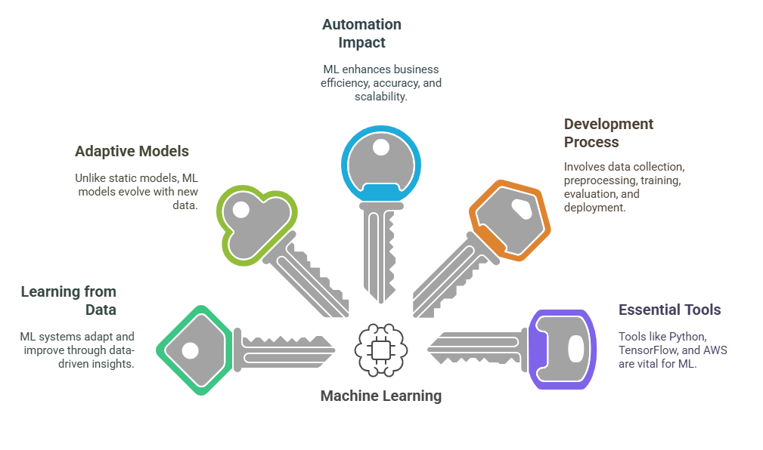
5 Key Learning Points of this Lesson
Notes:
Machine Learning (ML) and its Advantages: Machine Learning enables systems to learn from data and improve over time without the need for explicit programming. This means that instead of writing detailed rules for every scenario, a machine can analyze data and create its own logic based on patterns it identifies. As a result, ML allows systems to adapt to new information, making them more flexible and efficient than traditional rule-based models.
Traditional Models vs. ML Models: Traditional models are typically rule-based and static, meaning they rely on predefined instructions to make decisions. In contrast, ML models are data-driven and adaptive, meaning they can learn from new data and adjust their behavior accordingly. This ability to evolve and adapt makes ML models much more versatile in dealing with real-world, dynamic environments.
The Role of ML in Automation: ML is an essential tool for automation, helping businesses improve their efficiency, accuracy, and scalability. By automating tasks that were previously time-consuming or error-prone, businesses can reduce operational costs and free up resources for more strategic activities. Additionally, ML models can handle large volumes of data and complex tasks that would be difficult or impossible for humans to manage manually.
The ML Model Development Process: The process of developing an ML model involves several key steps, starting with data collection and preprocessing to ensure the data is clean and usable. After this, the model is trained on the data, evaluated for performance, and deployed into a real-world environment. Each of these steps requires careful attention to detail to ensure the model performs accurately and effectively.
Essential Tools for ML Development: To build, train, and deploy ML models, various tools and frameworks are required. Python, with libraries like TensorFlow, is one of the most commonly used programming languages for machine learning due to its simplicity and extensive library support. Cloud platforms like AWS also provide scalable resources, making it easier to handle large datasets and complex model training processes.

Slide 10
Thank You!
Shahriar’s Analytical Academy

